Slide 1




COPD Case Study
Truong Thi Minh Thu
Reference:
ttps://bit.ly/2YvSnaD

Slide 2
Chief complaint:
Mr TLT is a 58 year old taxi driver who presented with shortness of breath for the past four days.

Slide 3
History of present illness (HPI):
Mr TLT is a chronic smoker for the past 40 years who has been smoking about twenty sticks of cigarettes a day. He had been diagnosed with hypertension for the past one year and is currently on T Amlodipine 5 mg od.
Mr TLT has been having intermittent chronic cough for the past 3 years. The cough is productive at times. The sputum produced is mucoid in nature and about one tablespoonful in amount. There is no blood in the sputum. It is also not foul-smelling. Mr TLT then proceeded to have shortness of breath for the past one year. The dyspnoea is persistently present and described as requiring increased effort to breathe. It is worse on exertion and Mr TLT experinces reduced effort tolerance. He is now able to climb one and a half flights of stairs before becoming breathless. He has not consulted any doctors for these symptoms prior to admission.

Slide 4
History of present illness (HPI):
Mr TLT then developed symptoms of upper respiratory tract infection such as rhinorrhea and sore throat one week prior to admission. He had fever of 38 degress celcius at that time which resolved with paracetamol. He also had a productive cough with mucoid sputum at this time. Mr TLT then developed increasing shortness of breath 4 days prior to admission. The shortness of breath worsened over the 4 days and was associated with noisy breathing. He was breathless even at rest but was still able to speak in sentences. There was also an increase in cough as well as production of sputum. The sputum was mucoid and non purulent. He also did not notice any blueness around his lips or at his fingers.
Systemic review: There was no loss of appetite or loss of weight. He had mild ankle oedema but no other signs of heart failure such as orthopnoea or paroxysmal nocturnal dyspnoea.
Notes:
orthopnoea : khó thở khi nằm

Slide 5
Past medical history (PMH):
Mr TLT has not had any hospital admissions prior to this.
He was diagnosed with hypertension last year as an incidental finding during a visit to the kilinik kesihatan for an upper respiratory tract infection. He is currently taking tablet Amlodipine 5 mg once daily.

Slide 6
Family history (FH):
Mr TLT is the eldest of 5 siblings.
There is a strong family history of hypertension in that his mother as well as two other siblings are also hypertensive.
There is no family history of asthma, diabetes or ischaemic heart disease.

Slide 7
Social history (SH):
Mr TLT used to work as a taxi driver but has stopped working full time 2 years ago. He still occasionally drives his taxi but spends more time at home with his family.
He is a chronic smoker for the past 40 years and smokes about 20 sticks of cigarrettes a day.
He drinks alcohol with his friends on weekends. He drinks one to two bottles of beer each time.

Slide 8
CLINICAL EXAMINATION:
General examination (Gen):
Mr TLT was well nourished and alert but was tachypnoiec.
He was able to speak in sentences but there was use of his accessory muscles.
There was no clubbing or cyanosis seen.
There was also no peripheral oedema, pallor or jaundice.
Notes:
tachypnoiec nhịp nhanh.
accessory muscles: cơ phụ

Slide 9
CLINICAL EXAMINATION:
Vital signs (VS):
Pulse rate: 72 beats per minute, regular with good volume. No bounding pulse.
Respiratory rate: 28 breaths per minute
Blood pressure: 129/73
Temperature: 37 degrees Celsius
SpO2: 95% under nasal prong oxygen 3 litres per minute

Slide 10
CLINICAL EXAMINATION:
Respiratory system:
On inspection of the hands, there was no peripheral cyanosis or flapping tremors seen. There was also no clubbing, muscle wasting or palmar erythema seen. There was presence of nicotine stains.
The jugular venous pressure is mildly elevated at 3.5 cm above the sternal angle.
On palpation of the trachea, the trachea is central but the cricosternal distance is 2 fingers which is reduced.
The apex beat could not be palpated.
Notes:
Khám bàn tay: không tím ngoại biên, không run vẫy, không ngón tay dùi trống, không lòng bàn tay son, không teo cơ. Có vết nicotin.
TMC nổi 3.5cm trên góc ức.
Khí quản không lệch, khoảng cách ức-sụn nhẫn giảm, ~2 khoác ngón tay
cricosternal distance: khoảng cách từ bờ dưới sụn nhẫn đến xương ức
The cricosternal distance is the distance between the inferior border of the cricoid cartilage and the sternum.
To measure it, put the index finger of your right hand on the patient’s trachea against the inferior edge of the cricoid cartilage. Place subsequent fingers, in the vertical plane, below this into the sternal notch until the trachea is no longer palpable and the sternum is reached.
This is the crico-sternal distance and is normally three finger widths (5cm) or more. Note whether the trachea moves inferiorly, reducing the crico-sternal distance on inspiration, referred to as tracheal tug.
A reduction in the crico-sternal distance and tracheal tug signify marked chest hyperexpansion, usually COPD.
Nguồn: oxfordmedicaleducation

Slide 11
CLINICAL EXAMINATION:
Respiratory system:
On inspection of the chest, there is an increased anterior posterior diameter giving rise to a barrel shaped chest.
The chest moves equally with respiration and there is use of accessory mucles with intercostal, subcostal and suprasternal retraction.
There are no chest wall deformities.
Notes:
* Nhìn:
- Tăng đường kính trước sau, lồng ngực hình thùng
- Lồng ngực di động đều theo nhịp thở
- Có sử dụng cơ hô hấp phụ (có sợ co cơ gian sườn, cơ dưới sườn và cơ trên ức)
- Không có biến dạng thành ngực

Slide 12
CLINICAL EXAMINATION:
Respiratory system:
On palpation, chest expansion is reduced on both sides. Tactile fremitus is equal on both sides.
On percussion, there is hyperresonance over both lungs with loss of liver and cardiac dullness.
On auscultation vesicular breathing is heard. There is generalised expiratory rhonchi. There is also fine early inspiratory crepitations heard at the lower zones of both lungs.
Notes:
* Sờ: Lồng ngực giảm dãn nở cả 2 bên. Rung thanh giảm đều 2 bên.
* Gõ: Gõ vang 2 phế trường, mất vùng đục trước gan và vùng đục trước tim.
* Nghe: Có rì rào phế nang, ran ngáy thì thở ra lan toả và ran nổ đầu thì hít vào ở 2 đáy phổi

Slide 13
CLINICAL EXAMINATION:
Cardiovascular system:
The apex beat could not be palpated.
There were no parasternal heaves or thrills palpable.
On auscultation, normal first and second heart sounds were heard.
There was mild bilateral pitting oedema.
Notes:
Mỏm tim không sờ chạm, không ổ đập bất thường, không rung miêu.
T1, T2 rõ
Phù ấn lõm 2 bên

Slide 14
CLINICAL EXAMINATION:
Abdomen:
On inspection, the abdomen is flat and moves with respiration. There was no guarding or tenderness. The liver and spleen were not palpable. There was no organomegaly.
Notes:
Bụng phẳng, di động đều theo nhịp thở, không điểm đau, không đề kháng, gan lách không sờ chạm, không sờ thấy khối u.

Slide 15
CLINICAL EXAMINATION:
Neurological system:
Normal

Slide 16
PROVISIONAL AND DIFFERENTIAL DIAGNOSES WITH REASONING
Provisional diagnosis:
Acute exacerbation of newly diagnosed chronic obstructive airway disease due to upper respiratory tract infection.
Câu chẩn đoán:
COPD nhóm?, nguyên nhân?, biến chứng? Bệnh nền? Vào đợt cấp nhẹ/TB/nặng?, phức tạp/không phức tạp? Do? Biến chứng?

Slide 17
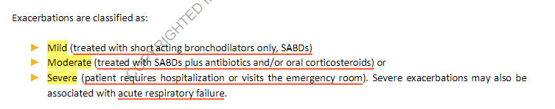
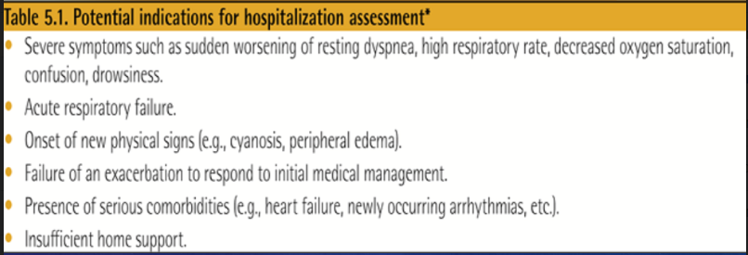

Slide 18
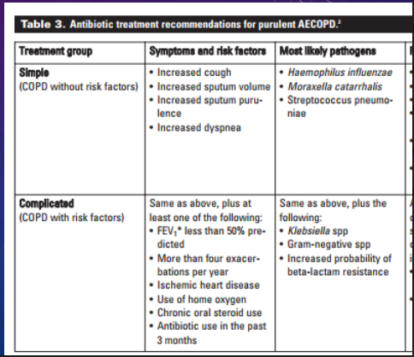

Slide 19
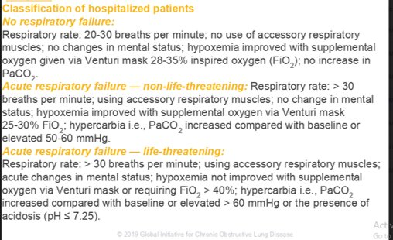

Slide 20
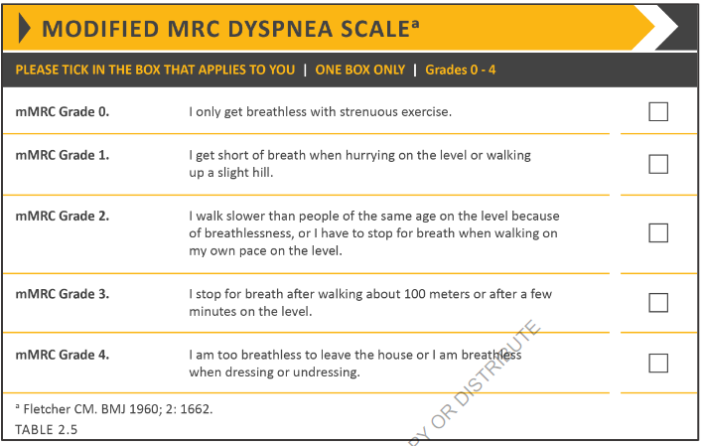

Slide 21
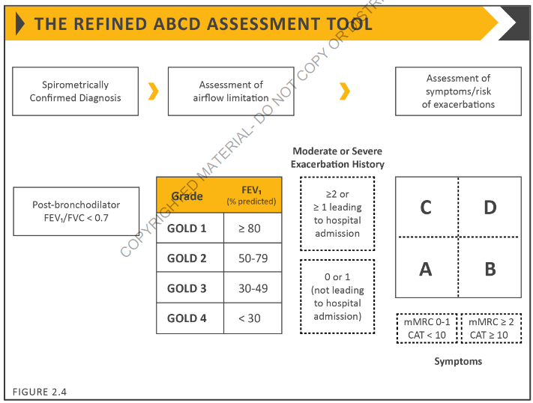

Slide 22


Slide 23
PROVISIONAL AND DIFFERENTIAL DIAGNOSES WITH REASONING
Chẩn đoán sơ bộ:
Đợt cấp COPD nặng, phức tạp do nhiễm trùng hô hấp trên biến chứng SHH(?)/COPD nhóm A, do hút thuốc lá, chưa biến chứng/THA.

Slide 24
PROVISIONAL AND DIFFERENTIAL DIAGNOSES WITH REASONING
Provisional diagnosis
Evidence for:
Patients with chronic obstructive airway disease (COPD) usually present with a persistent dyspnoea and reduced effort tolerance which was present in the history given by Mr TLT. He is also at increased risk of developing COPD due to exposure to associated risk factors such as tobacco smoke. He has been a chronic smoker for the past 40 years. There is also the presence of chronic cough occasionally associated with mucoid sputum which further suggests COPD. Physical findings of a hyperinflated chest and vesicular breathing with generalised expiratory rhonchi also point to an obstructive airway disease.

Slide 25
PROVISIONAL AND DIFFERENTIAL DIAGNOSES WITH REASONING
Provisional diagnosis
Evidence for:
During this admission Mr TLT had increasing severity of shortness of breath even at rest. This was associated with a wheeze that was described as noisy breathing. Sudden worsening of symptoms suggest an episode of acute exacerbation. The history of upper respiratory tract infection symptoms suggest that it was the trigger for this episode of exacerbation.

Slide 26
PROVISIONAL AND DIFFERENTIAL DIAGNOSES WITH REASONING
Differential diagnosis:
1) Congestive cardiac failure.
Mr TLT may have developed congestive cardiac failure as a primary event or as a complication of chronic lung disease. There is history of reduced effort tolerance. Patients with congestive cardiac failure may also present with a wheeze and sudden increase in dyspnoea. Physical examination of fine crepitations at both bases of the lungs may also indicate congestive cardiac failure. There is also evidence of mildly raised JVP as well as mild pittint ankle oedema.

Slide 27
PROVISIONAL AND DIFFERENTIAL DIAGNOSES WITH REASONING
Differential diagnosis:
1) Congestive cardiac failure.
Evidence against:
There is no history of any cause of heart failure such as ischaemic heart disease or cardiac valve defect. Mr TLT’s previous records during follow-up show well controlled blood pressure.
Additional investigations need to be carried out in order to rule out this condition. A chest plain radiograph may be done in order to look for evidence of heart failure such as cardiomegaly. An ECG may be done to look for right atrial hypertrophy. An echocardiogram should also be performed in order to assess the function of the ventricles.

Slide 28
PROVISIONAL AND DIFFERENTIAL DIAGNOSES WITH REASONING
Differential diagnosis:
2) Bronchiectasis:
Patients with bronchiectasis have a history of chronic cough as well as production of copious amounts of sputum. They may also have persistent shortness of breath, reduced effort tolerance and wheeze.

Slide 29
PROVISIONAL AND DIFFERENTIAL DIAGNOSES WITH REASONING
Differential diagnosis:
2) Bronchiectasis:
Evidence against:
The sputum produced by Mr TLT is mucoid in nature and not purulent which is typical in bronchiectasis. It is also not copious and foul smelling in nature. On physical examination, coarse crepitations would be heard in bronchiectasis as opposed to the fine crepitations heard in Mr TLT. There is also no evidence of clubbing.
Chest plain radiograph should be done in order to look for thickened bronchial walls or cystic shadows.

Slide 30
IDENTIFY AND PRIORITISE THE PROBLEMS
1. Shortness of breath and reduced effort tolerance
Mr TLT’s chief complaint is shortness of breath. This may be attributed to the increase in number of goblet cells and later on fibrosis of the bronchial walls causing airway obstruction seen in chronic obstructive airway disease. The shortness of breath may be partially relieved with the use of nebulization of ipratropium bromide, salbutamol and normal saline or with the use of metered dose inhalers. Chest physiotherapy may also be useful.
Mr TLT also has had reduced effort tolerance and persistent dyspnoea for the past a year. As such he may require the use of ipratropium bromide in a metered dose inhaler upon discharge in order to feel less breathless due to the bronchodilator effect of the ipratropium bromide.

Slide 31
IDENTIFY AND PRIORITISE THE PROBLEMS
2. Upper respiratory tract infection
Mr TLT may require antibiotics as he still has symptoms of upper respiratory tract infection such as sore throat. Furthermore patients who present with an acute exacerbation are at greater risk of having a bacterial infection. This is because of the depressed immune state that the patient is in as a result of the acute illness as well as due to any steroids that would be given as part of the management plan. The appropriateness of usage of antibiotics in chronic obstructive airway disease will be further discussed below.

Slide 32
IDENTIFY AND PRIORITISE THE PROBLEMS
3. Adequate inhaler technique
Mr TLT would need to be taught about the correct technique to be used when using metered dose inhalers. He would probably require daily use of ipratropium bromide metered dose inhalers to reduce his breathlessness. In the event that he is unable to learn proper technique, he may be encouraged to buy an aerochamber.

Slide 33
IDENTIFY AND PRIORITISE THE PROBLEMS
4. Smoking cessation
Mr TLT should be counseled on smoking cessation as it has been proven that smoking cessation would alter the course of progression in COPD and is associated with lower all-cause mortality. He should be counseled on the various options of smoking cessation which will be discussed further below.

Slide 34
PLAN OF INVESTIGATION, JUSTIFICATIONS FOR THE SELECTION OF TESTS OR PROCEDURES, AND INTERPRETATION OF RESULTS
1) Full Blood Count
Justification: In order to view the total white count as well as the differential count to see if there is an infection which has caused this episode of exacerbation. There may also be secondary polycythemia if the patient has chronic pulmonary hypertension.

Slide 35
Results:
White cell count : 7.91 X 109/L
Red blood cell : 4.48 X 1012/L
Haemoglobin : 133.00 g/dl
Haematocrit : 42.00 ratio
Mean cell volume : 93.80 fL
Mean cell haemoglobin : 29.70 pg
Mean cell haemoglobin conc. : 317.00 g/l
Platelets : 141.00 X 109/L
Differential count
Neutrophils : 60.10% 4.76 X 109/L
Lymphocytes : 25.30% 2.00 X 109/L
Monocytes : 13.80% 1.09 X 109/L
Eosinophils : 0.50% 0.04 X 109/L
Basophils : 0.30% 0.02 X 109/L

Slide 36
PLAN OF INVESTIGATION, JUSTIFICATIONS FOR THE SELECTION OF TESTS OR PROCEDURES, AND INTERPRETATION OF RESULTS
1) Full Blood Count
Interpretation: This is a normal full blood count result with normal total white count as well as normal haemoglobin levels.

Slide 37
PLAN OF INVESTIGATION, JUSTIFICATIONS FOR THE SELECTION OF TESTS OR PROCEDURES, AND INTERPRETATION OF RESULTS
2) Plain chest radiograph
Justification: Done in order to look for evidence of chronic obstructive airway disease such as hyperinflated chest or evidence of congestive cardiac failure such as cardiomegaly and prominent upper lobe vessels.

Slide 38
PLAN OF INVESTIGATION, JUSTIFICATIONS FOR THE SELECTION OF TESTS OR PROCEDURES, AND INTERPRETATION OF RESULTS
2) Plain chest radiograph
Results: Hyperinflation of the chest with the 7th anterior rib crossing the diaphragm. No other abnormalities seen.

Slide 39
PLAN OF INVESTIGATION, JUSTIFICATIONS FOR THE SELECTION OF TESTS OR PROCEDURES, AND INTERPRETATION OF RESULTS
2) Plain chest radiograph
Interpretation: Hyperinflation of the lung fields is consistent with the provisional diagnosis of chronic obstructive airway disease.

Slide 40
PLAN OF INVESTIGATION, JUSTIFICATIONS FOR THE SELECTION OF TESTS OR PROCEDURES, AND INTERPRETATION OF RESULTS
3) Sputum FEME, culture and sensitivity (not done)
Justification: In order to look for any bacteria which may have been the cause of the exacerbation . If there any organism cultured, proper antibiotics can be given based on the sensitivity test.

Slide 41
PLAN OF INVESTIGATION, JUSTIFICATIONS FOR THE SELECTION OF TESTS OR PROCEDURES, AND INTERPRETATION OF RESULTS
4) Arterial blood gas (not done)
Justification: May be necessary in severe cases of breathlessness to look for respiratory failure and associated changes in blood pH.

Slide 42
PLAN OF INVESTIGATION, JUSTIFICATIONS FOR THE SELECTION OF TESTS OR PROCEDURES, AND INTERPRETATION OF RESULTS
5) Blood urea serum electrolytes and creatinine
Justification: To look for renal impairment which may be present due to Mr TLT having hypertension. Renal impairment may also affect the dosage and type of antibiotics used.

Slide 43
PLAN OF INVESTIGATION, JUSTIFICATIONS FOR THE SELECTION OF TESTS OR PROCEDURES, AND INTERPRETATION OF RESULTS
5) Blood urea serum electrolytes and creatinine
Results:
Urea : 3.7mmol/L
Sodium : 135 mmol/L
Potassium : 3.7 mmol/L
Creatinine : 65 umol/L

Slide 44
PLAN OF INVESTIGATION, JUSTIFICATIONS FOR THE SELECTION OF TESTS OR PROCEDURES, AND INTERPRETATION OF RESULTS
5) Blood urea serum electrolytes and creatinine
Interpretation: Normal result. There is no renal impairment

Slide 45
PLAN OF INVESTIGATION, JUSTIFICATIONS FOR THE SELECTION OF TESTS OR PROCEDURES, AND INTERPRETATION OF RESULTS
6) Electrocardiogram
Justification: To look for evidence of right ventricular hypertrophy or right atrial hypertrophy which may be seen in chronic lung disease.

Slide 46
PLAN OF INVESTIGATION, JUSTIFICATIONS FOR THE SELECTION OF TESTS OR PROCEDURES, AND INTERPRETATION OF RESULTS
6) Electrocardiogram
Results: ECG with sinus rhythm. There is no P pulmonale seen. There is low voltage seen. No ischaemic changes seen. No left ventricular hypertrophy.

Slide 47
PLAN OF INVESTIGATION, JUSTIFICATIONS FOR THE SELECTION OF TESTS OR PROCEDURES, AND INTERPRETATION OF RESULTS
6) Electrocardiogram
Interpretation: Normal ECG with low voltage is seen in a hyperinflated chest such as in patients with COPD

Slide 48
WORKING DIAGNOSIS
Acute exacerbation of chronic obstructive airway disease due to upper respiratory tract infection

Slide 49
PLAN OF MANAGEMENT ON ADMISSION
Acute management
1. Provide supplemental oxygen via nasal prong 3L/min and maintain SpO2 above 90%. Arterial blood gas should be done in order to ensure adequate oxygenation without carbon dioxide retention of acidosis.
2. Close monitoring of vital signs and SpO2 hourly until the patient’s breathlessness improves. Nursing staff to inform if patient deteriorates such as increased respiratory rate or drop in oxygen saturation below 92%.
3. Give nebulization of Ipratropium Bromide:Salbutamol:Normal Saline in ratio of 2:2:1 every four hours until breathlessness decreases.
4. Oral prednisolone 40mg once daily for 10 days
5. Postural drainage and chest physiotherapy may be performed.
6. Oral antibiotics such as T. Cefuroxime may be given. This was not given in this patient with further discussion below.

Slide 53
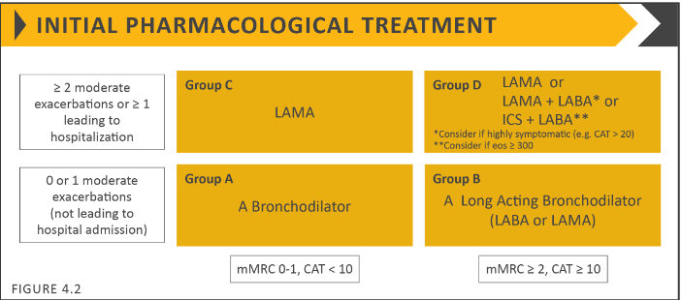

Slide 54
PLAN OF MANAGEMENT ON ADMISSION
Long term management
1. MDI ipratropium bromide 40 microgrammes tds
2. MDI salbutamol 200 microgrammes PRN
3. Counseling on proper inhaler technique.
4. Couseling on smoking cessation.

Slide 55
SUMMARY OF INPATIENT PROGRESS
Mr TLT was warded for a total of 3 days. His breathlessness improved after nebulization with ipratropium bromide, salbutamol and normal saline for one day. He no longer required nebulization after one day. Mr TLT was also able to ambulate without feeling breathless. He was able to eat and to sleep well without being bothered by the dyspnoea. His vital signs were also normal and his respiratory rate improved to about 20 breaths per minute. There was still some ronchi heard on auscultation but it was much reduced. He was afebrile during his stay.

Slide 56
SUMMARY OF INPATIENT PROGRESS
Mr TLT was discharged after 3 days of admission and educated on chronic obstructive airway disease. He was also counseled on the importance of smoking cessation. He was given an appointment with the medical outpatient department in one month time in order to review his symptoms after being given MDI ipratropium bromide. He was told to return to the hospital if he had similar episodes.

Slide 57
DISCHARGE PLAN
1. Medications:
i. MDI Salbutamol 200µg PRN
ii. MDI Ipratropium Bromide 40µg TDS
iii. T. Amlodipine 5mg once daily
iv. T. Prednisolone 20mg od for 7 days.

Slide 58
DISCHARGE PLAN
2. Counseling on COPD and use of metered dose inhaler
Mr TLT should be taught about the correct technique in using a metered dose inhaler. The technique should then be assessed before discharge. In the event that Mr TLT is unable to coordinate well, he may be advised to purchase an aerochamber.

Slide 59
DISCHARGE PLAN
3. Counseling on smoking cessation
The approach to counseling a patient on smoking cessation as well as various options will be further discussed below.
4. Education on the symptoms of an acute exacerbation and advise to return to the hospital if there is development of those symptoms.
5. For follow-up at the medical outpatient department for review of symptoms while on MDI ipratropium bromide. He should also be taught about pulmonary rehabilitation. A spirometry appointment may also be made.

